Slide 1


Assembly Validation

Slide 2
Assembly
What is an assembly?
“Draft de novo genome assemblies are now available for many organisms. These assemblies are point estimates of the true genome sequences. Each is a specific hypothesis, drawn from among many alternative hypotheses, of the sequence of a genome. Assembly uncertainty, the inability to distinguish between multiple alternative assembly hypotheses, can be due to real variation between copies of the genome in the sample, errors and ambiguities in the sequenced data and assumptions and heuristics of the assemblers. Most assemblers select a single assembly according to ad hoc criteria, and do not yet report and quantify the uncertainty of their outputs. Those assemblers that do report uncertainty take different approaches to describing multiple assembly hypotheses and the support for each.”
Howison et al. 2013. Bioinformatics.

Slide 3
Evaluating assemblies
What can we do to evaluate an assembly?
Polish first (Pilon, NanoPolish, Quiver/Arrow, etc).
Assembly statistics
K-mer statistics
Assembly graph structure
Read alignment statistics and properties
Contamination assessment
Gene space statistics
Comparative alignment

Slide 4
Basic assembly statistics
Percentage of assembly in scaffolded contigs 4.2%
Percentage of assembly in unscaffolded contigs 95.8%
Average number of contigs per scaffold 1.0
Average length of break (>25 Ns) between contigs in scaffold 191
Number of contigs 9082
Number of contigs in scaffolds 72
Number of contigs not in scaffolds 9010
Total size of contigs 22857451
Longest contig 621740
Shortest contig 56
Number of contigs > 1K nt 2527 27.8%
Number of contigs > 10K nt 329 3.6%
Number of contigs > 100K nt 34 0.4%
Number of contigs > 1M nt 0 0.0%
Number of contigs > 10M nt 0 0.0%
Mean contig size 2517
Median contig size 571
N50 contig length 25795
L50 contig count 158
NG50 contig length 188047
LG50 contig count 8
N50 contig - NG50 contig length difference 162252
contig %A 28.57
contig %C 21.46
contig %G 21.39
contig %T 28.58
contig %N 0.01
contig %non-ACGTN 0.00
Number of contig non-ACGTN nt 0

Slide 5
Basic assembly statistics
Percentage of assembly in scaffolded contigs 4.2%
Percentage of assembly in unscaffolded contigs 95.8%
Average number of contigs per scaffold 1.0
Average length of break (>25 Ns) between contigs in scaffold 191
Number of contigs 9082
Number of contigs in scaffolds 72
Number of contigs not in scaffolds 9010
Total size of contigs 22857451
Estimated genome size 4.66Mb (4660000)

Slide 6
Basic assembly statistics
Longest contig 621740
Shortest contig 56
Number of contigs > 1K nt 2527 27.8%
Number of contigs > 10K nt 329 3.6%
Number of contigs > 100K nt 34 0.4%
Number of contigs > 1M nt 0 0.0%
Number of contigs > 10M nt 0 0.0%
Mean contig size 2517
Median contig size 571
N50 contig length 25795
L50 contig count 158
NG50 contig length 188047
LG50 contig count 8
Poor Assembly.
Many contigs
< 1kb

Slide 7
Basic assembly statistics
N50 is a common statistical measure of sequence length.
The size of the smallest contig in the set of largest contigs that make up 50% of the assembly size.

Slide 8
Basic assembly statistics
N50 has multiple disadvantages though
N50 is not a measure of assembly correctness
It only measures sequence contiguity
N50 is not meaningful for different assembly sizes.
It’s not comparable across species, and technically even the same genome.
N50 does not improve for near complete assemblies.
Once you have good scaffolds, only small contigs remain.
N50 is biased if short sequences are excluded.
Often shorter contigs are filtered out from the assembly.

Slide 9
Basic assembly statistics
A better statistic is NG50
The size of the smallest contig in the set of largest contigs that make up 50% of the (estimated) genome size (not assembly).
It is still only a measure of sequence contiguity, but comparable for the same genome.
There is still a limit on when it will not improve further.
Smaller contigs can be filtered out without affecting the value.

Slide 10
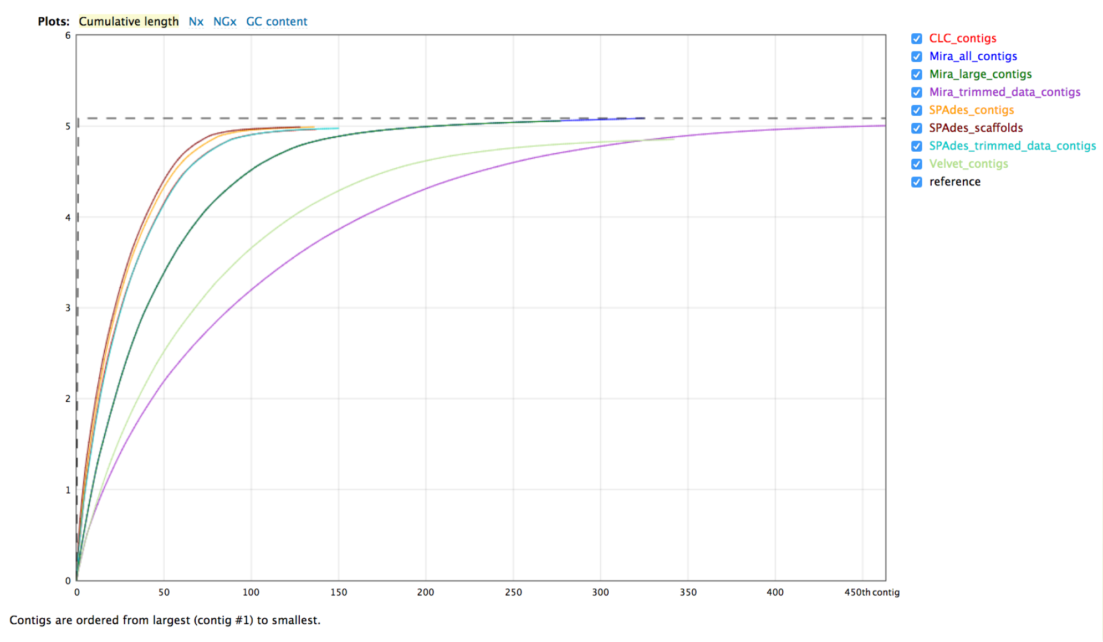
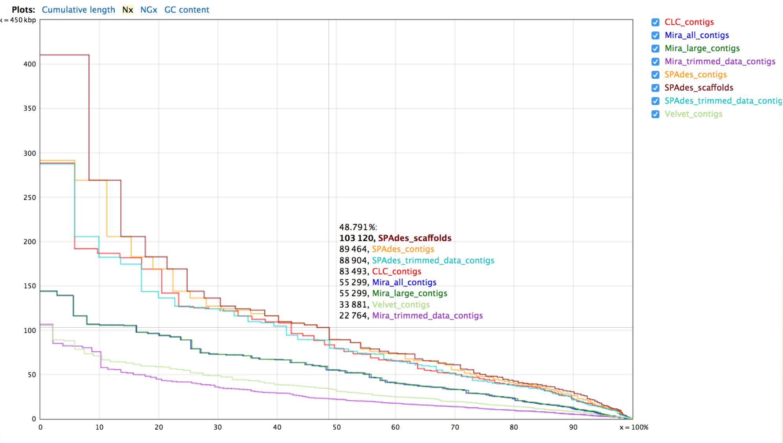
Basic assembly statistics
Tool: Quast
Produces comparisons of assemblies
Statistics include number of contigs, N50, NG50, GC content

Slide 11
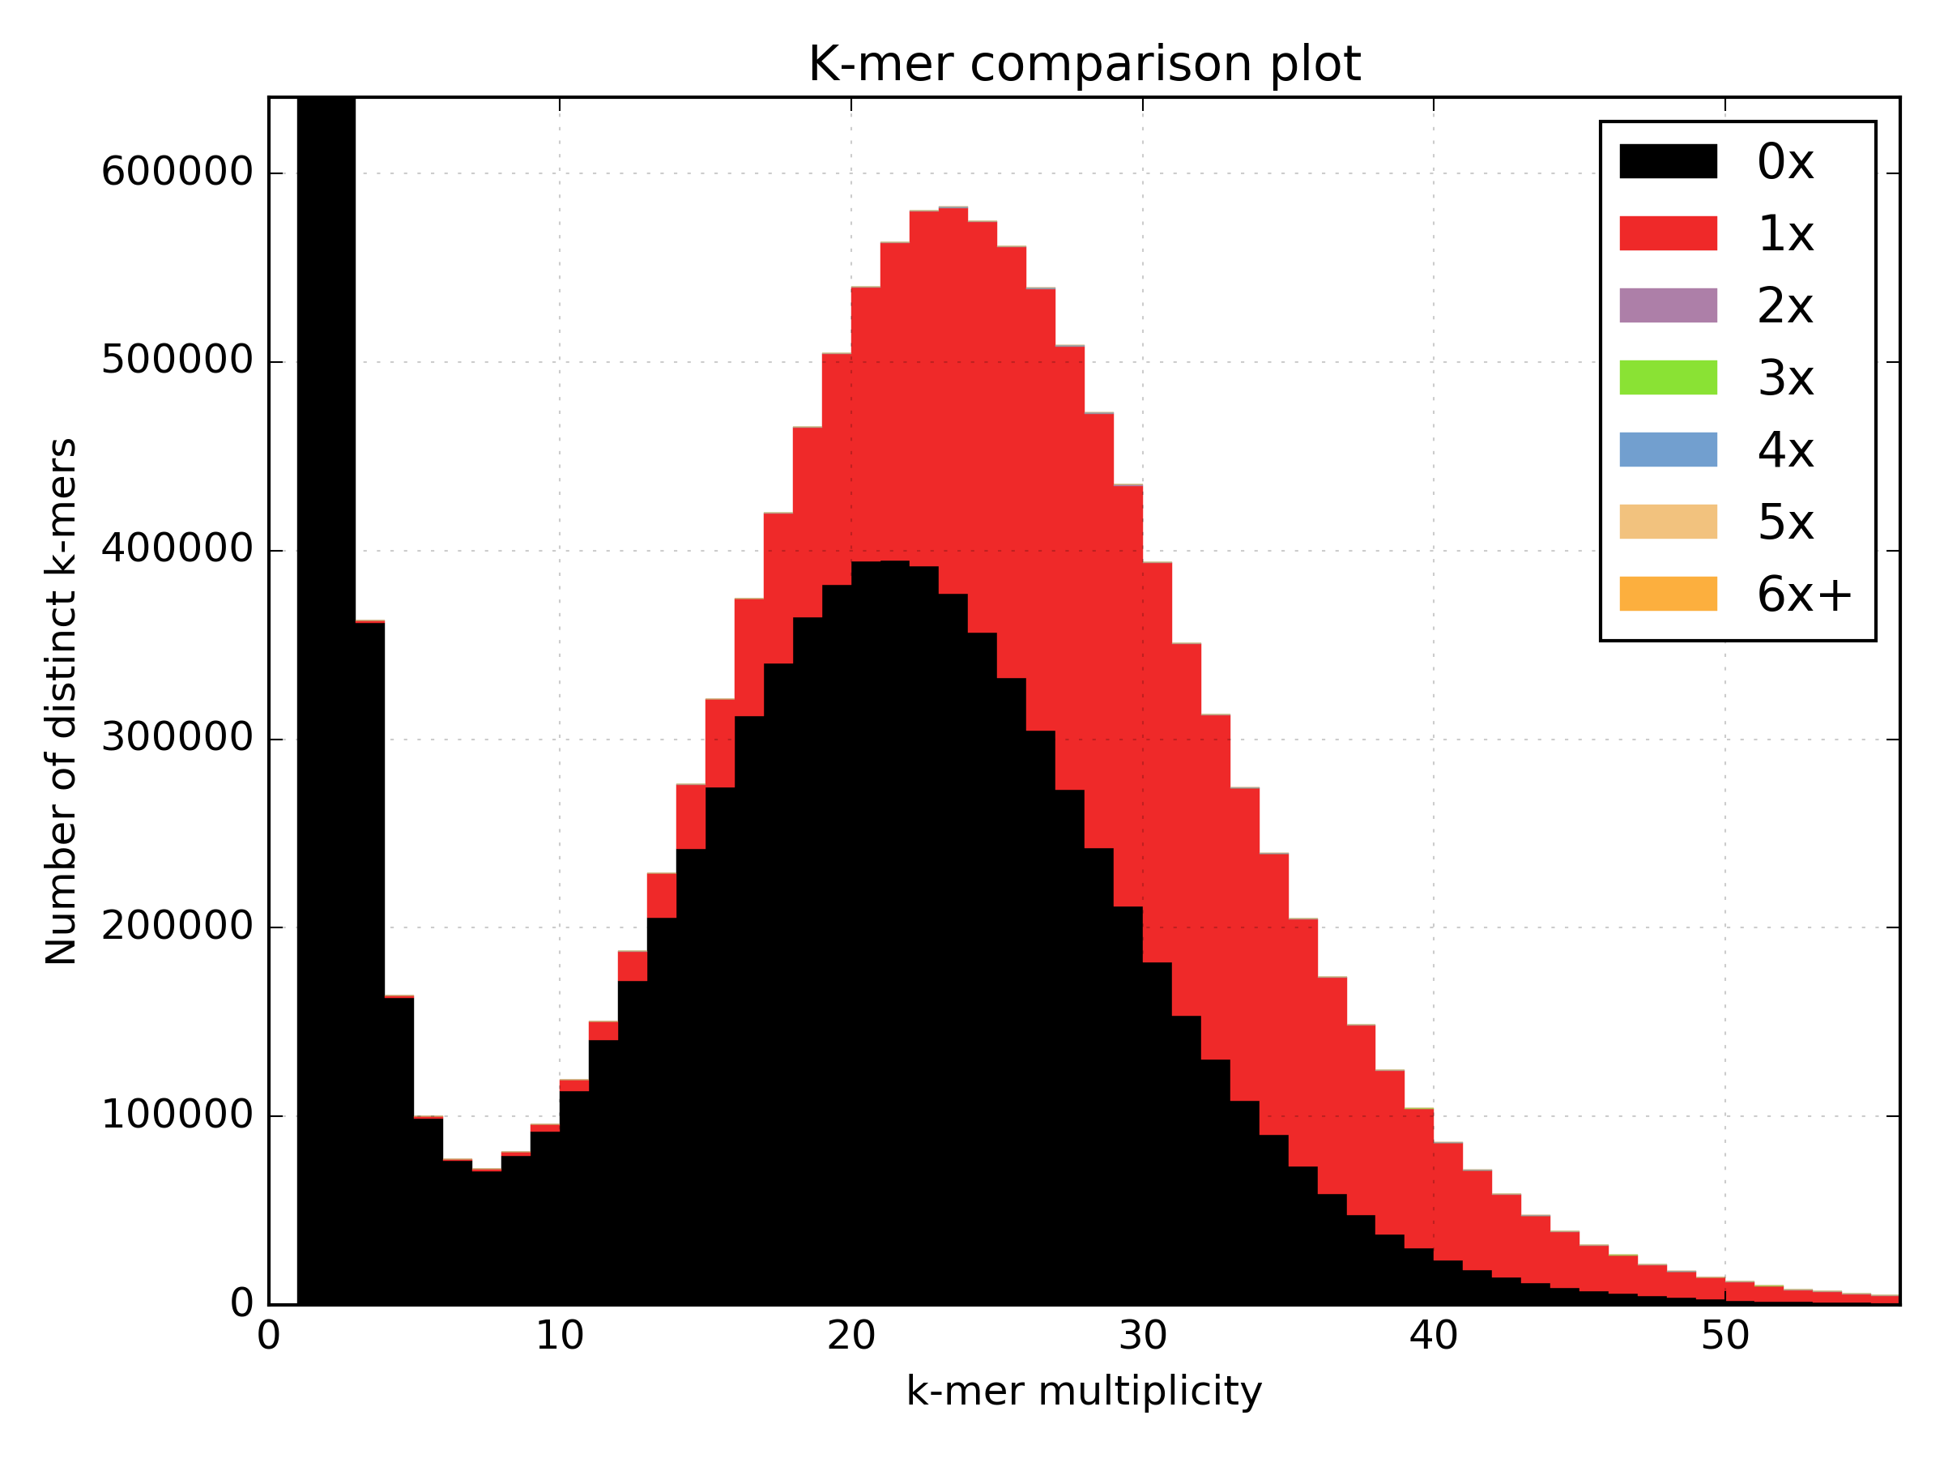
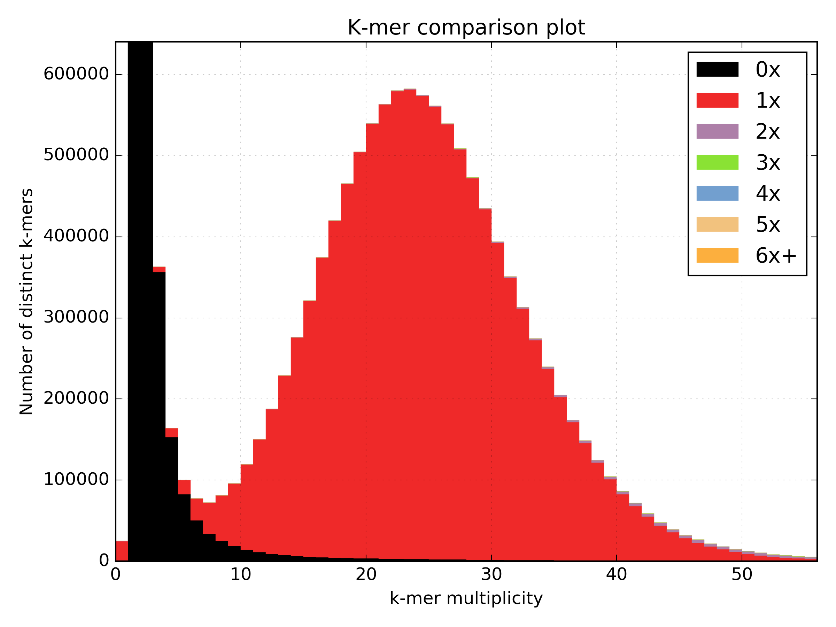
K-mer statistics
K-mer Analysis Toolkit
K-mer comparison plots indicate how well the genome is assembled.
Poor - Many high frequency are k-mers missing from the assembly
Good - Most high frequency are found in the assembly

Slide 12
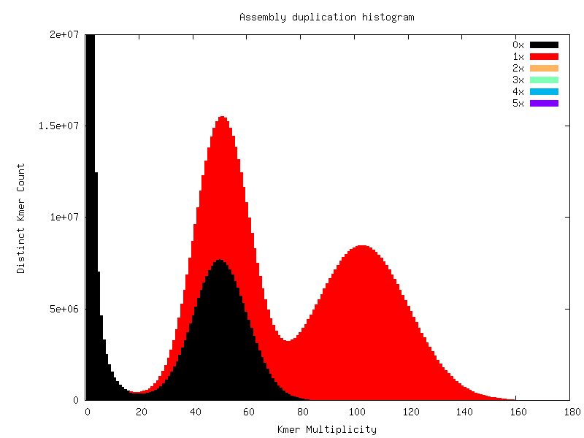
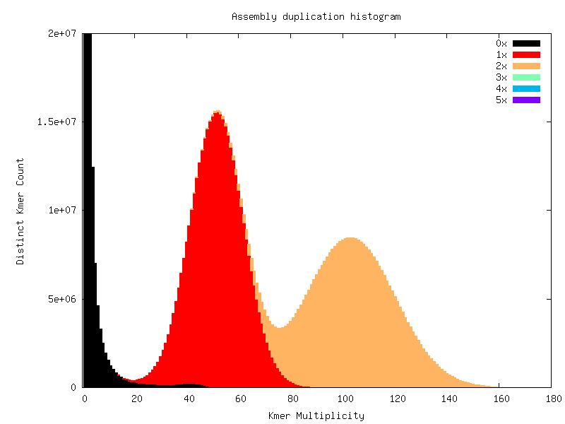
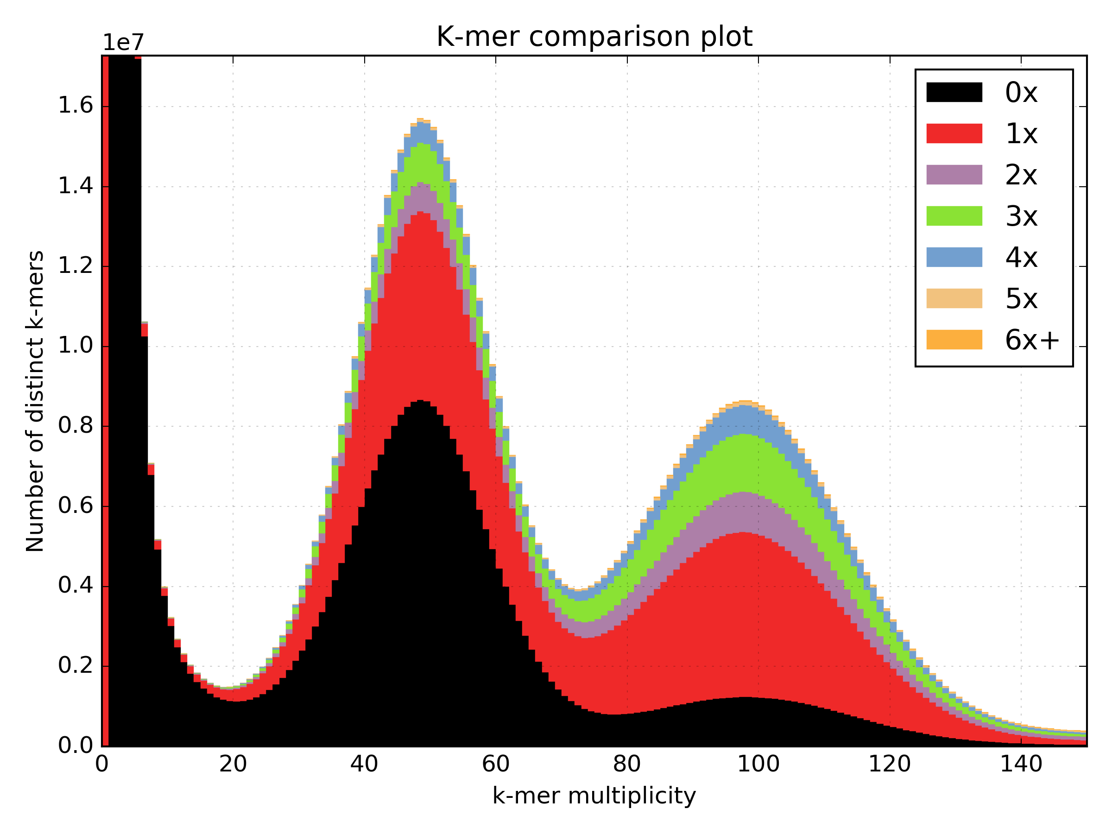
K-mer statistics
K-mer Analysis Toolkit
Good
Bad

Slide 13
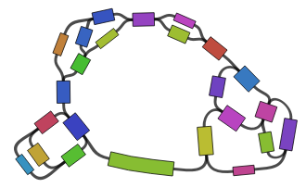
Assembly graph structure
Assemblies are written in fasta/q format.
Loses connection information between the contigs/scaffolds.
Some assemblers also write GFA format (Graphical Fragment Assembly)
Keeps the relationship between contigs.
Visualized using Bandage

Slide 14
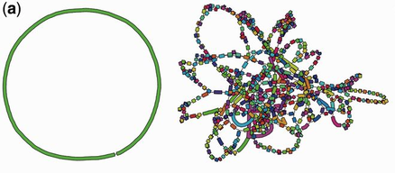
Assembly graph structure
Ideal bacterial assembly graph
Poor assembly

Slide 15
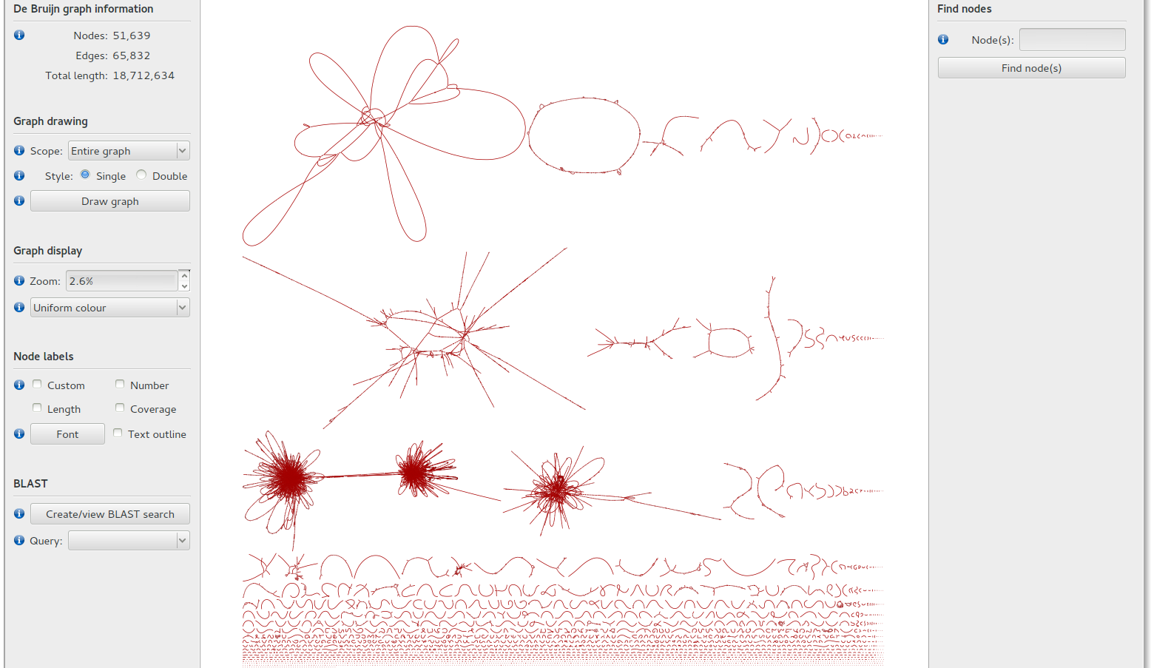
Assembly graph structure

Slide 16
Read alignment statistics
Samtools flagstat <bamfile>
27190072 + 0 in total (QC-passed reads + QC-failed reads)
0 + 0 secondary
584370 + 0 supplementary
0 + 0 duplicates
25987447 + 0 mapped (95.58% : N/A)
26605702 + 0 paired in sequencing
13302851 + 0 read1
13302851 + 0 read2
23321920 + 0 properly paired (87.66% : N/A)
25250050 + 0 with itself and mate mapped
153027 + 0 singletons (0.58% : N/A)
1196126 + 0 with mate mapped to a different chr
439746 + 0 with mate mapped to a different chr (mapQ>=5)

Slide 17
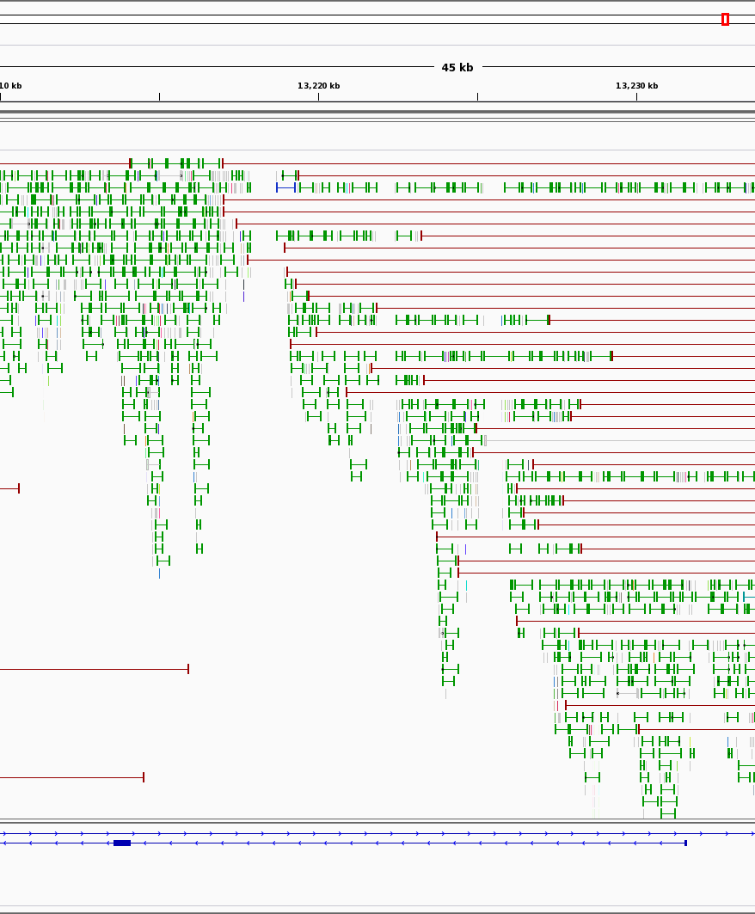
Read alignment properties
Aligning reads back to the draft assembly tells us about data congruency.
Which areas of the assembly have no / reduced coverage?
Do paired reads align to different contigs?
Do paired reads align to close or too far apart?
Do paired reads align in the wrong orientation?

Slide 18
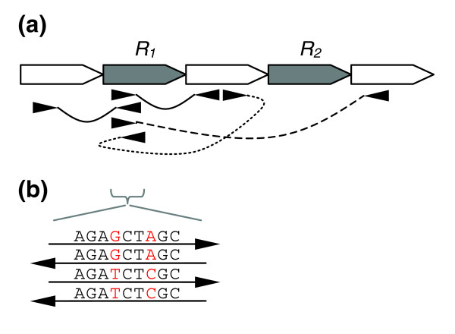
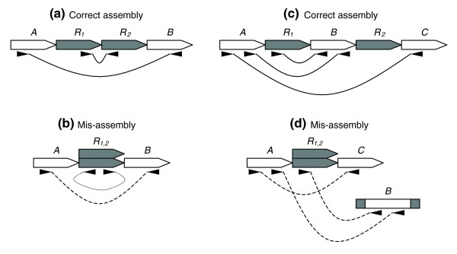
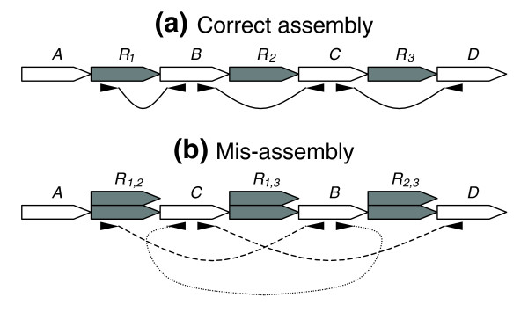
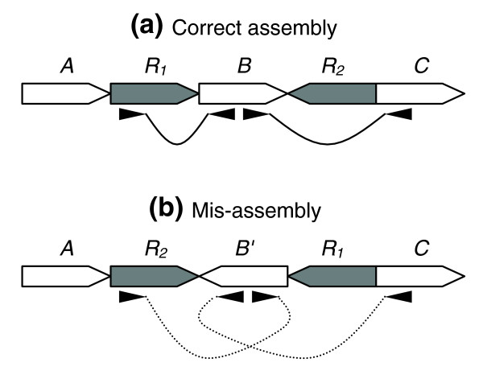
Read alignment properties

Slide 19
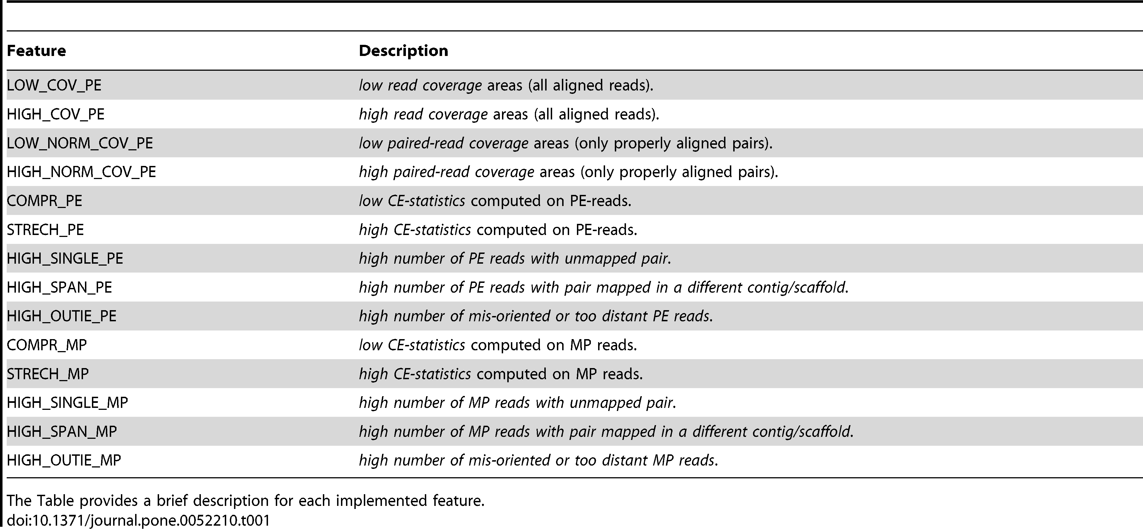
Read alignment properties
FRCBam

Slide 20
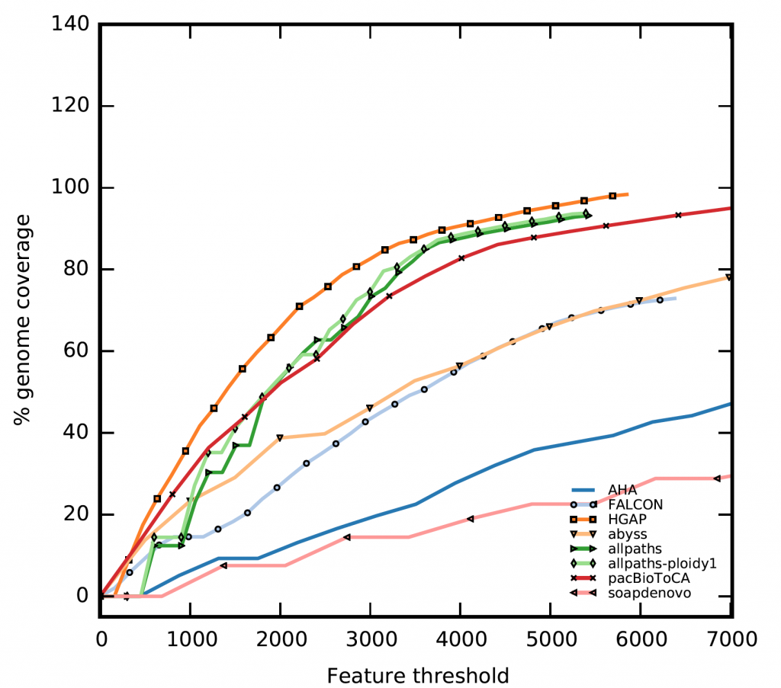
Read alignment properties
FRCBam
Feature Response Curve (only comparable if estimated genome size is used).
The best assembly has the least features.

Slide 21
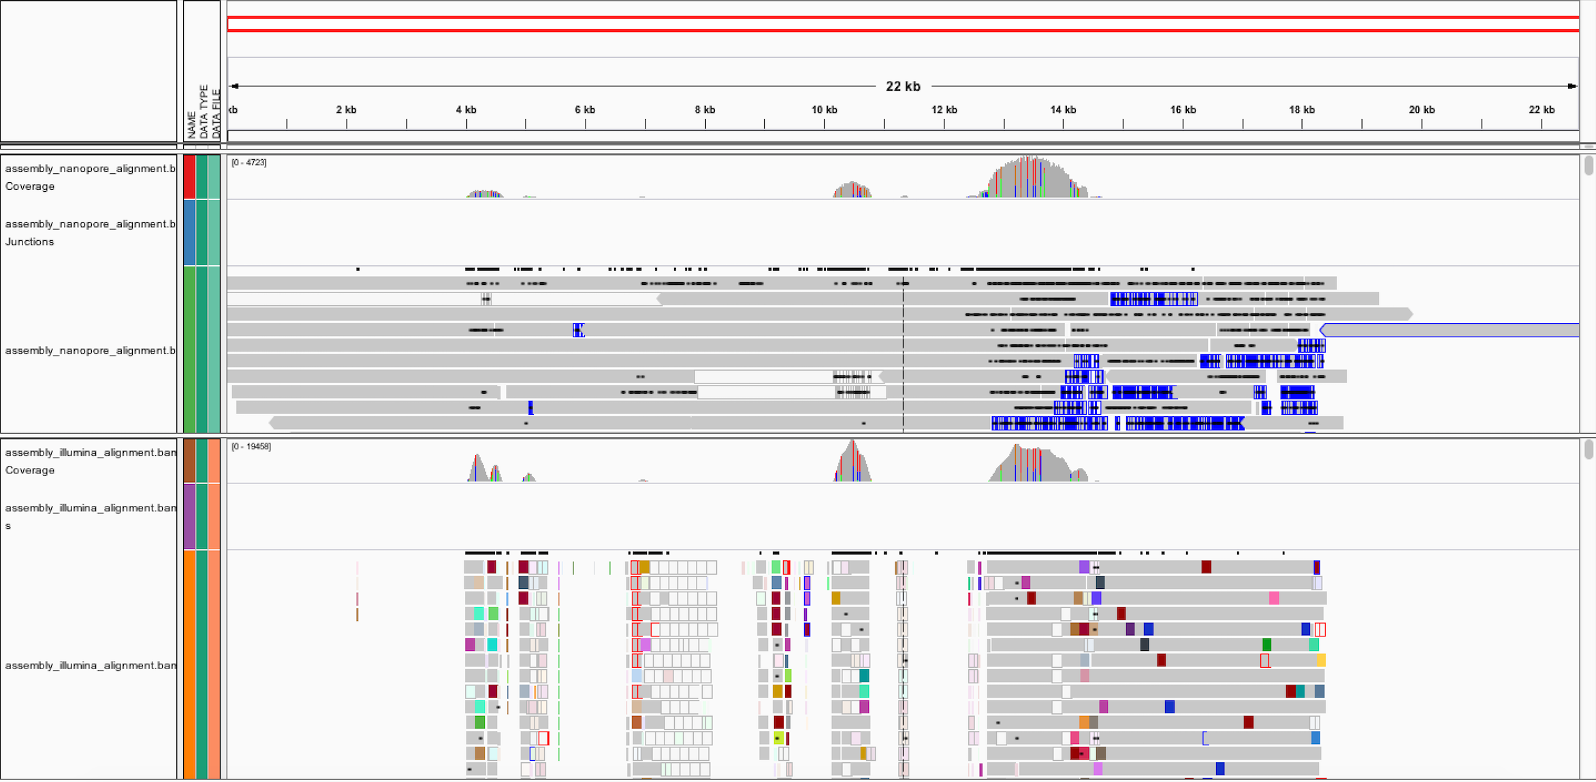
Read alignment properties
IGV - Genome Browser
Coverage tracks show poor coverage
No read support

Slide 22
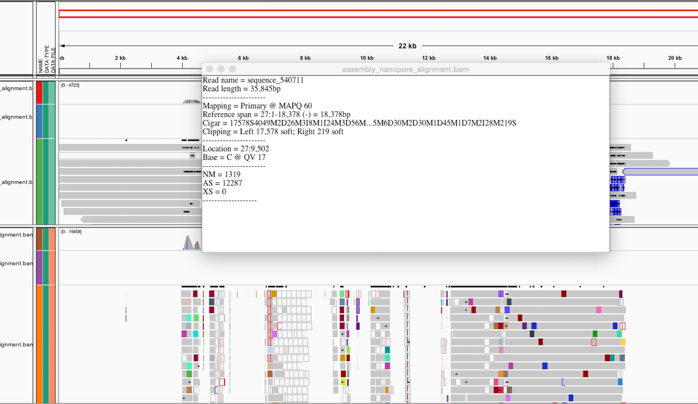
Read alignment properties
22kb contig
35kb read
Softpadded bases in alignment

Slide 23
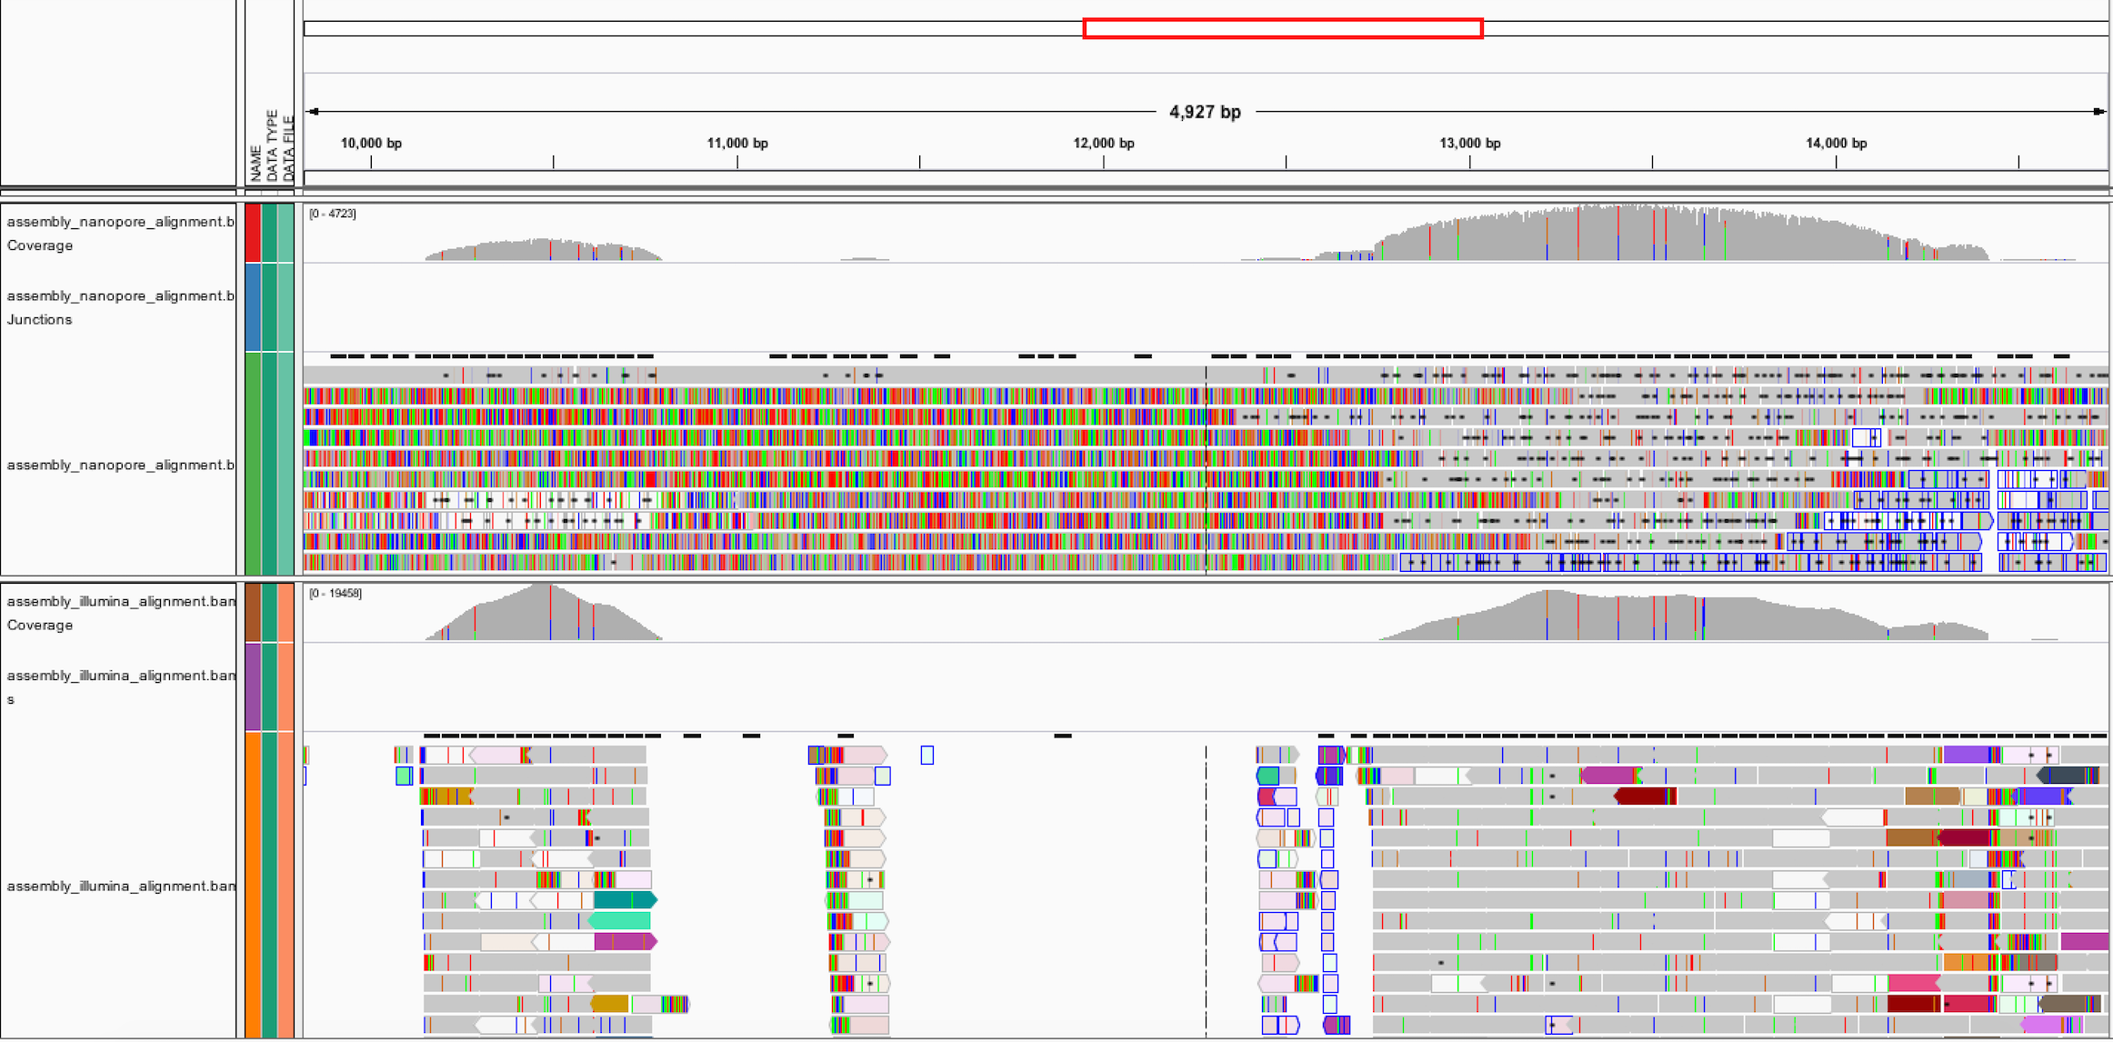
Read alignment properties
Bases in disagreement
Read pairs are inconsistent

Slide 24
Contamination assessment
Blobtools

Slide 25
Contamination assessment
Blobtools
Sign of bacterial contamination

Slide 26
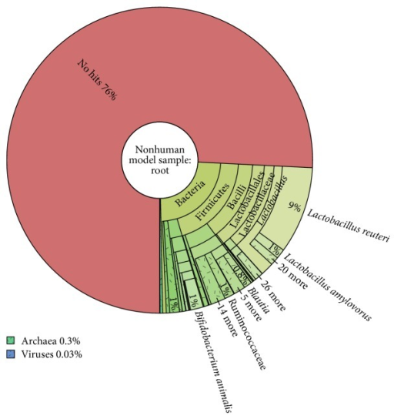
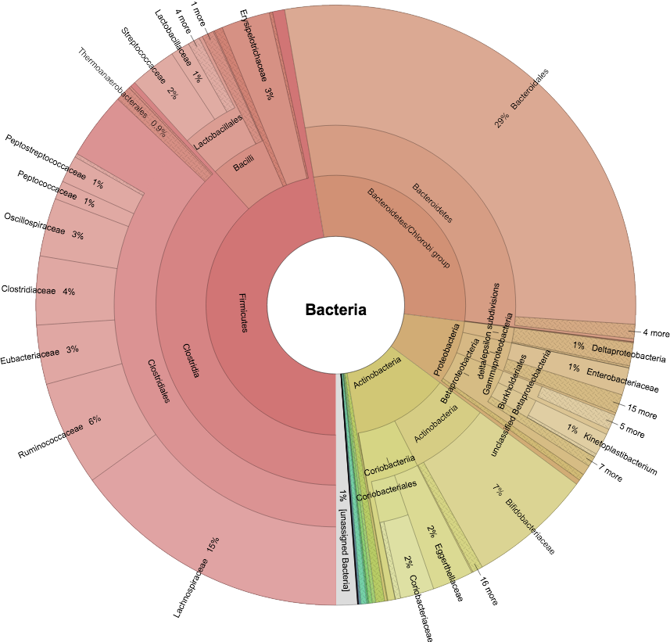
Contamination assessment
Kraken taxonomic classification

Slide 27
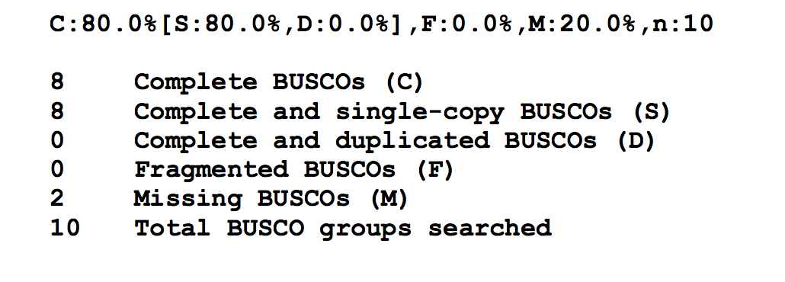
Gene space statistics
BUSCO v3 provides quantitative measures for the assessment of genome assembly based on evolutionarily-informed expectations of gene content from near-universal single-copy orthologs.
Bacteria
Eukaryota
Protists
Metazoa
Fungi
Plants

Slide 28
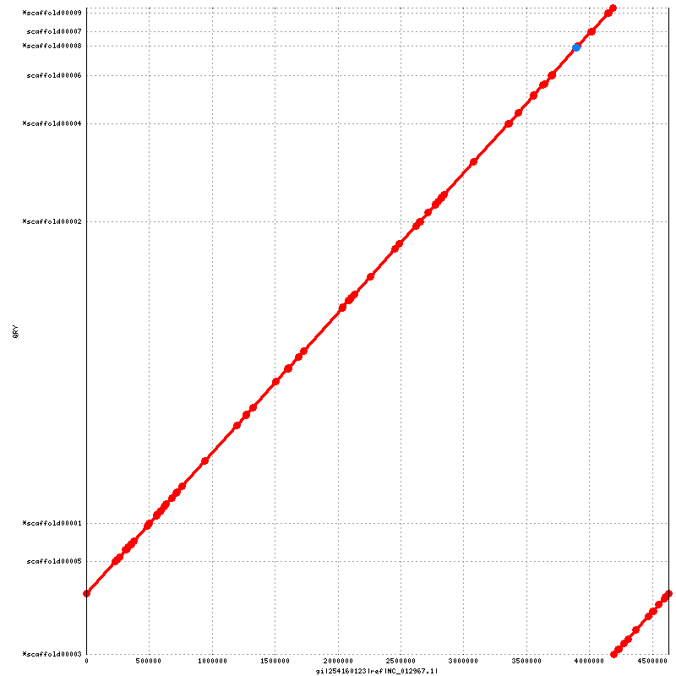
Comparative Alignment
Dot plots (Nucmer, Gepard, etc)

Slide 29
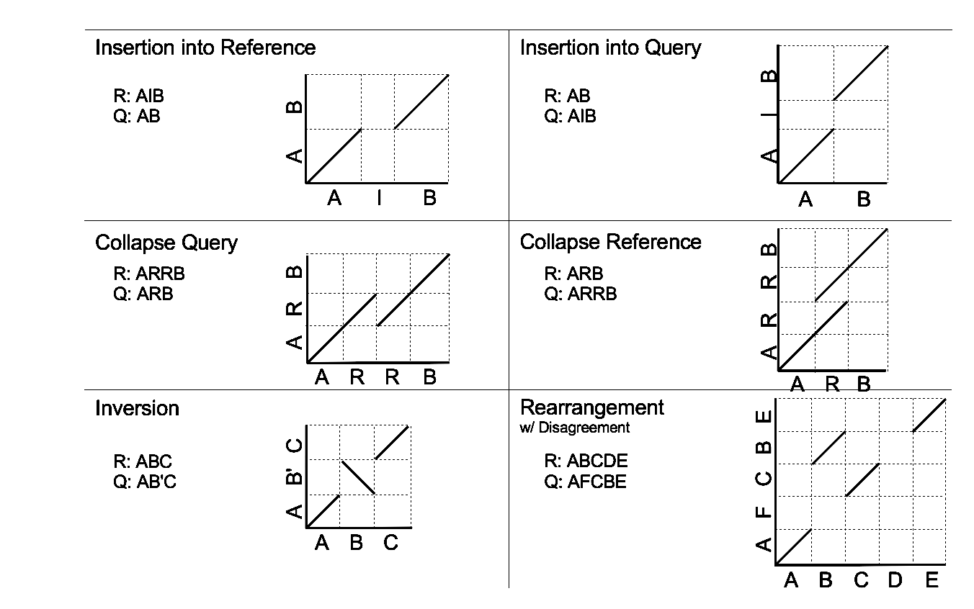
Comparative Alignment
Dot plots

Slide 30
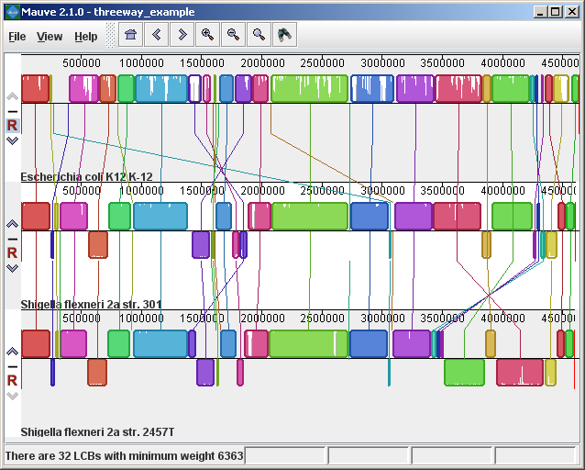
Comparative Alignment
Mauve

Slide 31
Improving your assembly
Highly exploratory.
Merging the best assemblies (assembly reconciliation) has been recently shown to not necessarily improve results.
Use the validation tools and assembly output to guide next steps.
Is coverage low after correction and trimming?
Change parameters to decrease minimum overlap depth
Increase overlap error rate
Is the assembly looking incomplete?
Can I get more data?
Is there contamination?
Align and filter

Slide 32
Correcting an assembly
Downstream processing assumes correct assembly
Repeats and heterozygosity complicate assembly, however misassemblies are a primary reason for failing to improve assemblies further.
This misassembly prevents the contigs from being scaffolded correctly

Slide 33
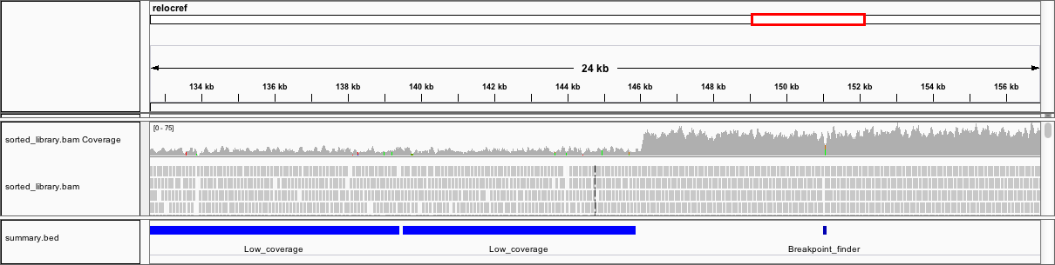
Correcting an assembly
Manually breaking a contig
Programs
Reapr
[GAP5]
(In a file editor)
[QuickMerge]
[BIGMAC]

Slide 34
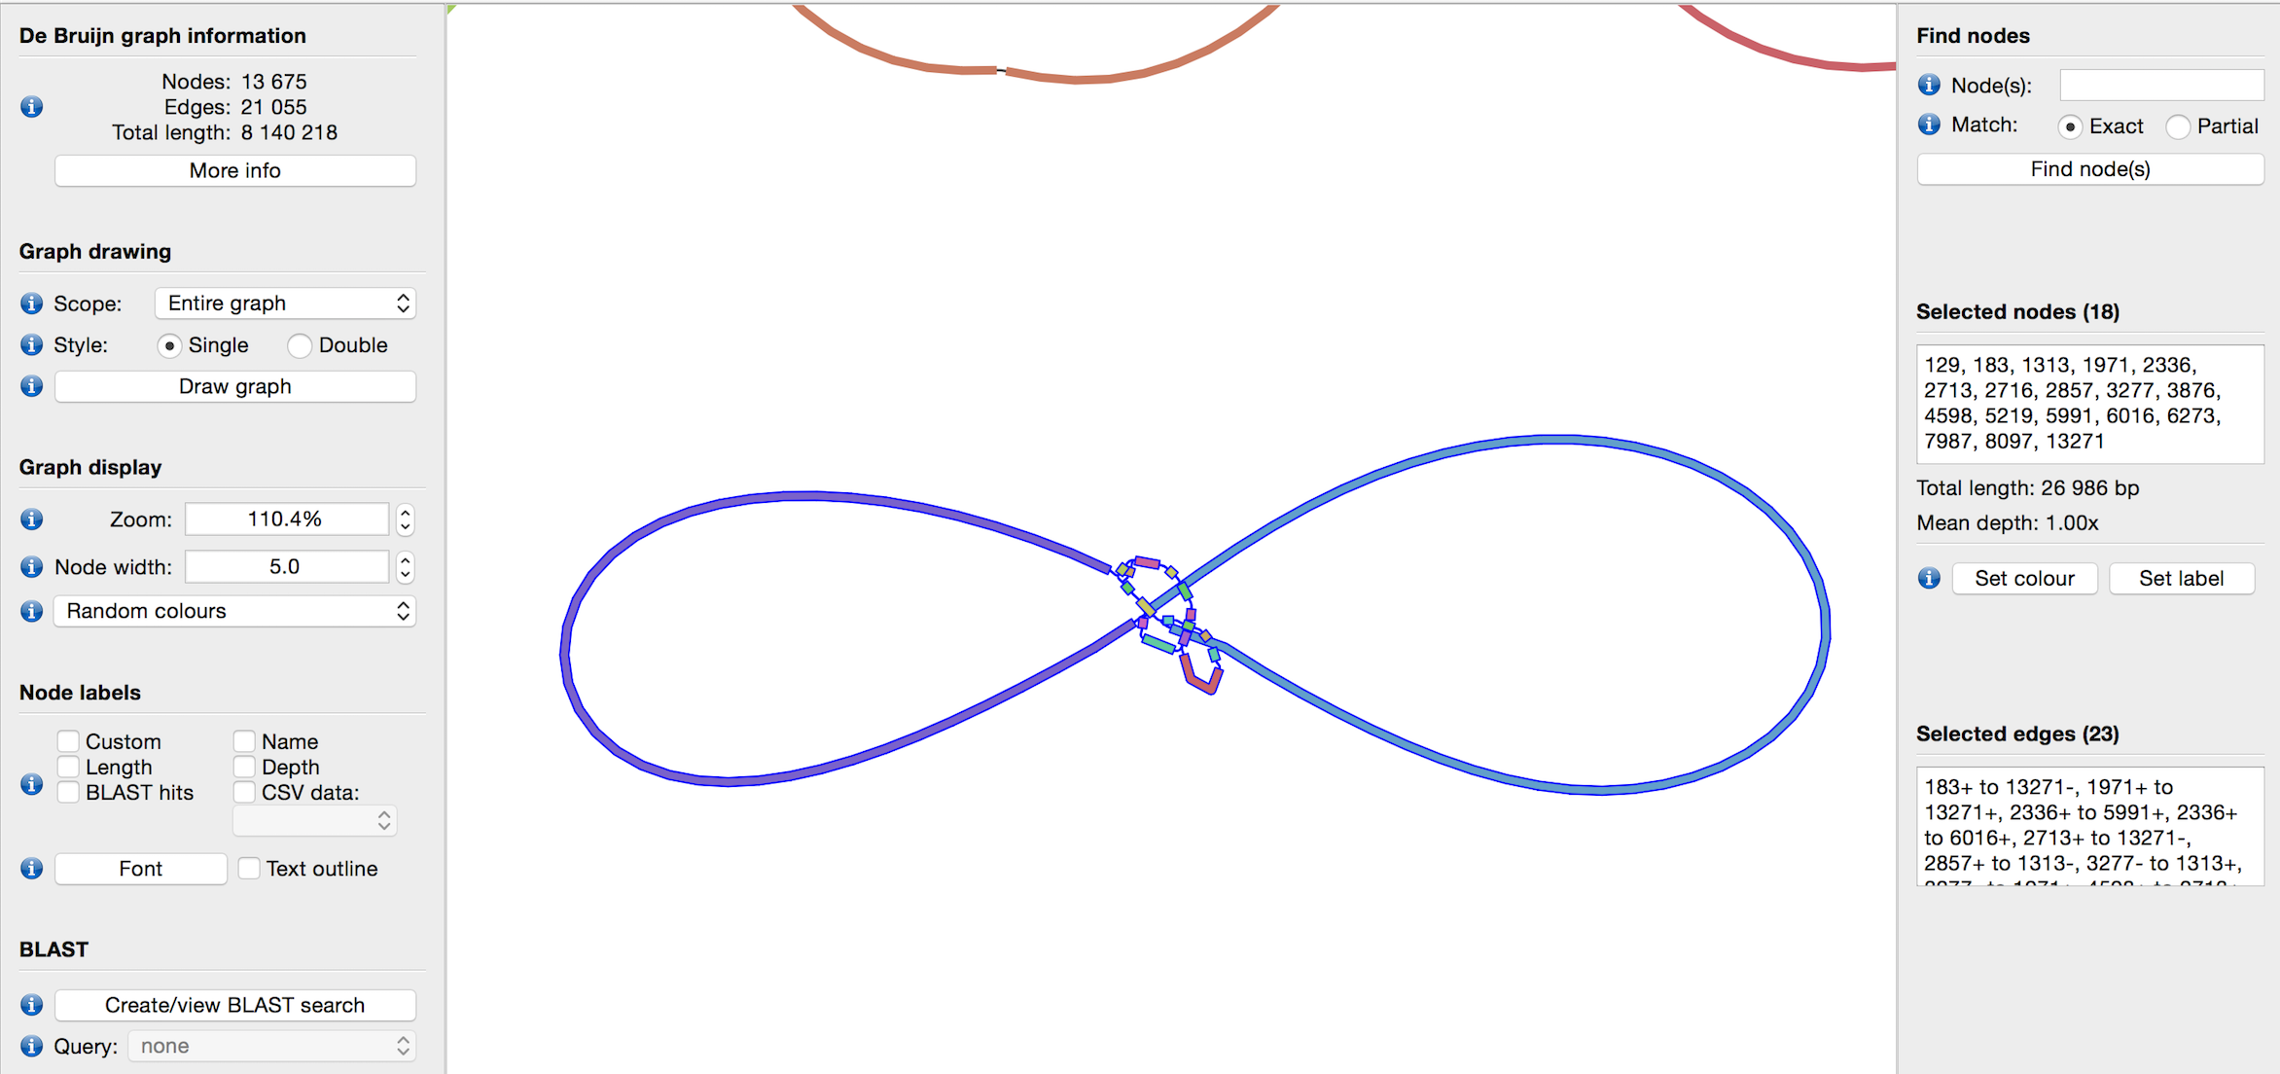
Data exploration
Evidence of COI gene found on this contig.
Hypothesis: This set of contigs make up the mitochondrial genome

Slide 35
Selecting the best assembly
Illumina
Quast
Assemblathon_statistics
KAT
Bandage
Samtools flagstat
FRCBam / Reapr
IGV
Blobtools
Kraken
BUSCO
PacBio / Nanopore
Quast
Assemblathon_statistics
Bandage
Samtools flagstat
(Bridge Mapper)
IGV
Blobtools
Kraken
BUSCO

